Slide 1
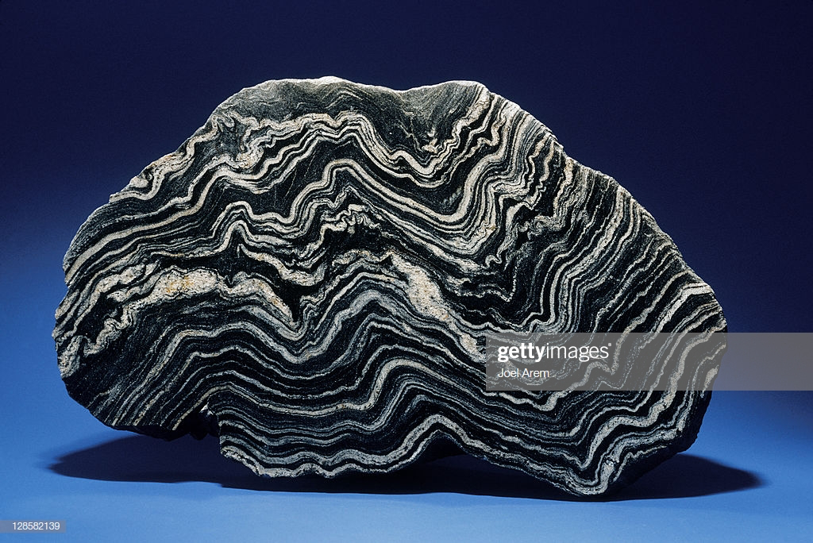
Metamorphism

Slide 2
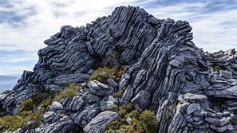
Metamorphism
Metamorphic rocks are the 3rd major type of rocks
Meta = change
Morphe = shape
They result from the transformation of other rocks by processes that typically occur beneath the earth’s surface.

Slide 3
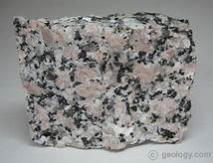
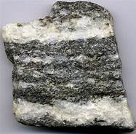
Metamorphism
During metamorphism rocks are subjected
to enough heat and pressure to change their
mineral composition, texture, or both
Therefore forming new rocks.
The new rocks usually do not
look like the original rock

Slide 4
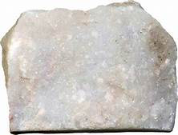
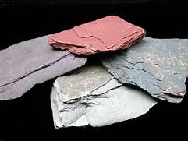
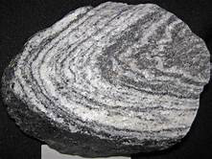
Metamorphism
Transformations occur BELOW the melting point….otherwise it would form an igneous rock!

Slide 5
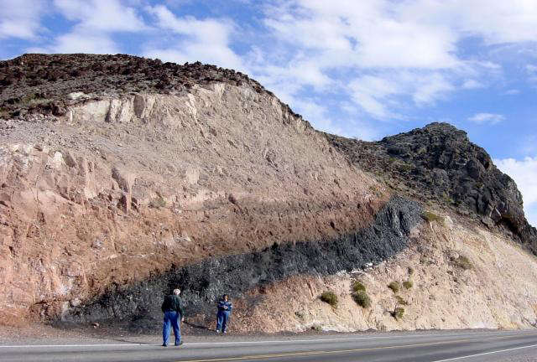
Metamorphism
Most people only recognize marble and slate
as metamorphic rocks….even though they
surround us!

Slide 6
Metamorphism
Metamorphic and igneous rocks compose a
large portion of the earth’s surface.
- including the crystalline basement rocks that underlie the sedimentary rocks at the surface.

Slide 7
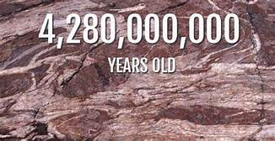
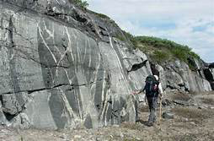
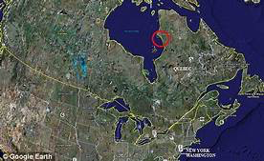
Metamorphism
Some of the oldest rocks found on earth’s surface are metamorphic!
that means they formed from even older rocks!

Slide 8
Agents of Metamorphism
There are 3 principle agents of metamorphism:
Heat
Pressure
Fluid Activity
Time is also important to metamorphism because chemical reactions take place at different rates.

Slide 9
Agents of Metamorphism
During metamorphism…
The original rock was in equilibrium with its environment.
(Meaning it was chemically and physically stable under those conditions.)

Slide 10
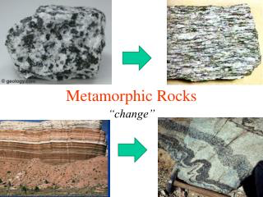
Agents of Metamorphism
As conditions in the rocks environment change, the original rock must undergo changes to achieve equilibrium with its new environment.
The changes may cause
new minerals to form,
texture to change, or
both to occur.

Slide 11
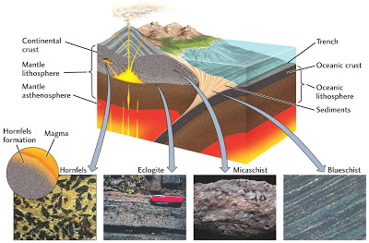
Heat
Heat is important to metamorphism because it can increase the rate reactions occur at.
Heat may come from
magma, lava, or as a
result of deep burial
in the crust because of
subduction near a
convergent boundary

Slide 12
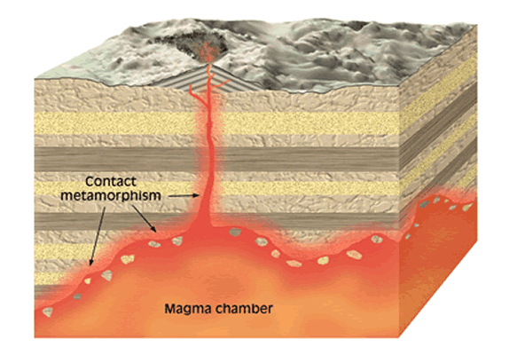
Heat
As magma intrudes the heat is strongest on the rocks closest and lessens the further away you get.
This creates a zone of metamorphism that is usually easy to recognize.

Slide 13
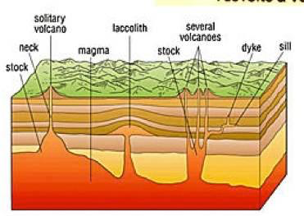
Pressure
During burial, rocks are subjected to greater pressure.
This is called lithostatic pressure
Stress applied
evenly in all
directions.

Slide 14
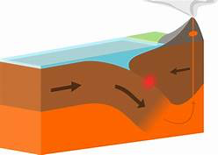
Pressure
Rocks may also experience differential pressure
Typically occurs at convergent boundaries.

Slide 15
Fluid Activity
Water and Carbon Dioxide exist in nearly every region of metamorphism.
These fluids impact metamorphism by increasing the rate at which reactions occur.

Slide 16
Fluid Activity
These fluids come mainly from 3 sources.
Water trapped in sedimentary pore spaces.
Volatile fluid within magma
Dehydration of water-bearing minerals (Such as Gypsum)

Slide 17
Types of Metamorphism
Geologist recognize 3 major types of metamorphism:
Contact (thermal) Metamorphism
Dynamic Metamorphism
Regional Metamorphism

Slide 18
Types of Metamorphism
Contact (thermal) Metamorphism
- heat and fluids from magma act to produce change.
Happens when a magma alters the surrounding country rock.

Slide 19
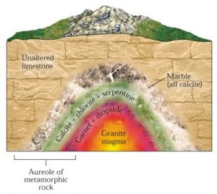
Types of Metamorphism
Intruding magma raises the temperature of surrounding rock….causing a “bake zone”
Release of hot fluids
into country rock by
the cooling intrusion
can also form new
minerals.

Slide 20
Types of Metamorphism
Important Factors to Contact Metamorphism:
Initial temperature
Size of the intrusion
Fluid content of the magma and country rock.

Slide 21
Types of Metamorphism
The area of metamorphism around an intrusion (the bake zone) is called the aureole.
Boundary between intrusion and aureole can be sharp or slowly transition
Will range in size depending on the size and cooling rate of the intrusion.

Slide 22
Types of Metamorphism
The degree of metamorphism will change throughout the “bake zone”
Closer to the intrusion = higher metamorphism
Farther from intrusion = low grade metamorphism

Slide 23
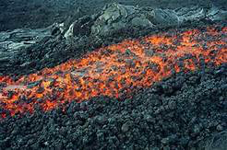
Types of Metamorphism
Contact Metamorphism can also be caused
by lava flows.

Slide 24
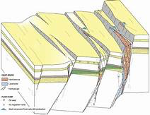
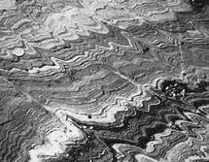
Types of Metamorphism
Dynamic Metamorphism:
Result of high difference in pressure associated with intense deformation.
Usually associated with faults or
fault zones.
rocks subjected to high levels of differential pressure

Slide 25
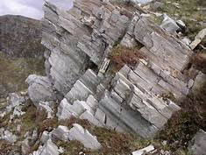
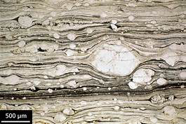
Types of Metamorphism
Rocks formed from pure dynamic metamorphism are called mylonites.
Restricted to narrow zones
next to the faults.
Mylonites are hard, dense,
fine-grained rocks within
thin laminations (layers)

Slide 26
Types of Metamorphism
Regional Metamorphism
occurs over a large area associated with major mountain building events.
Most metamorphic rocks result from regional metamorphism.
Occurs over large area caused by great temperature, pressure and deformation.

Slide 27
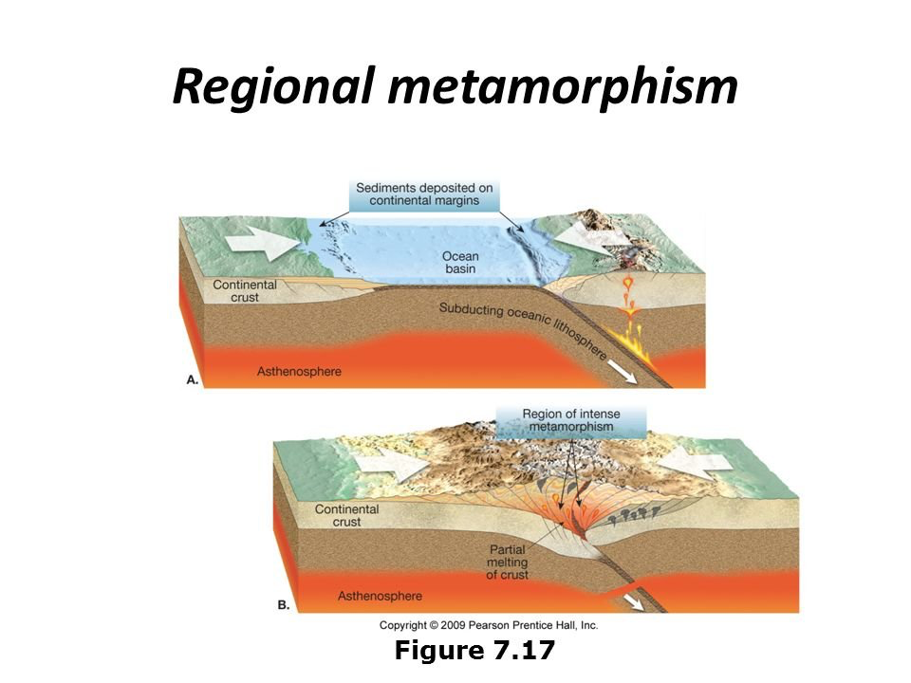
Types of Metamorphism
Regional metamorphism is most obvious along convergent boundaries
Regional metamorphism can also occur at divergent boundaries.

Slide 28
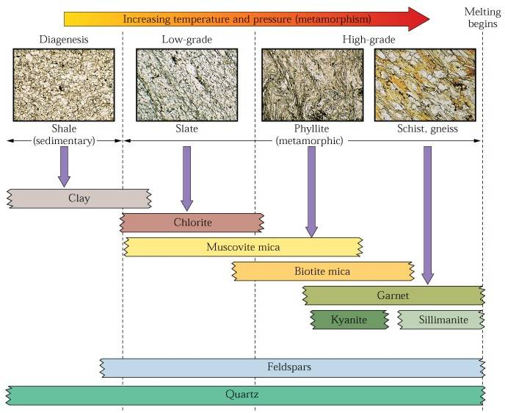
Index Minerals and Metamorphic Grade
Certain minerals are known to form only
within specific temperature and pressure
ranges.
These are known as INDEX MINERALS

Slide 29
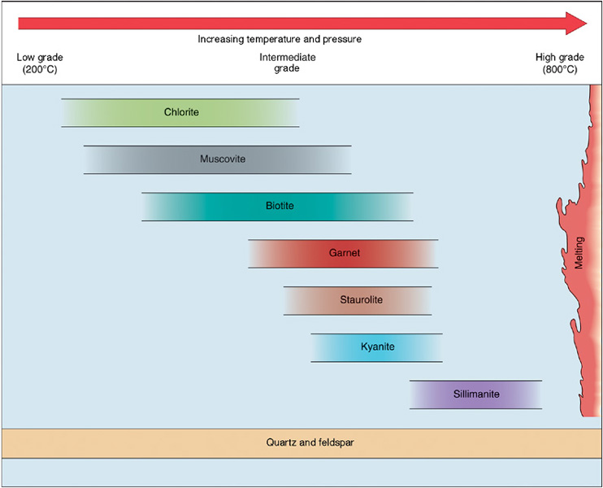
Index Minerals and Metamorphic Grade
The presence of index minerals allows geologists to identify low-, intermediate-, and high-grade metamorphism.

Slide 30
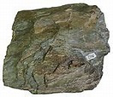
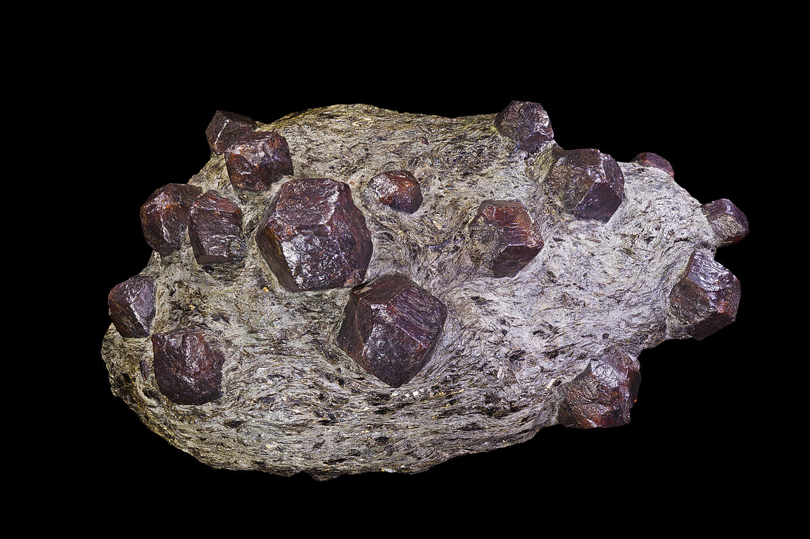
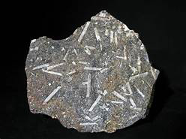
Index Minerals and Metamorphic Grade
Metamorphic grade generally describes the degree to which a rock has been metamorphosed or changed.
Chorite = low Garnet = intermediate Sillmanite = high

Slide 31
Index Minerals and Metamorphic Grade
The presence of index minerals help determine the metamorphic grade.
Ex. Chlorite = low grade
Garnet = intermediate grade
Sillmanite = high grade
Index minerals form based on the
composition of the parent rock.

Slide 32
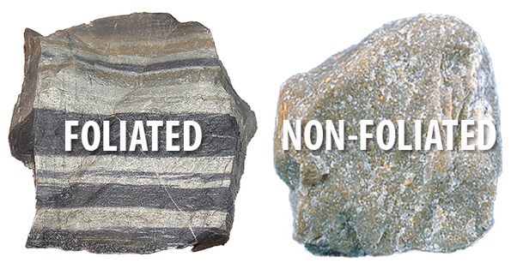
How are Metamorphic Rocks Classified?
Metamorphic rocks are commonly divided into 2 groups:
Foliated Texture 2. Nonfoliated Texture

Slide 33
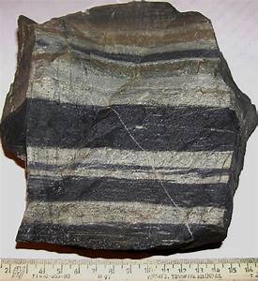
Foliated Metamorphic Rocks
Rocks that experience heat and differential pressure usually develop minerals arranged in a parallel fashion.
This is a foliated texture.
The size and shape of the mineral grains determines whether the foliation is fine or coarse

Slide 34
Foliated Metamorphic Rocks
Low grade metamorphic rocks are finely foliated (slate)
No individual grains visible
High grade metamorphic rocks are coarsely foliated (gneiss)
Individual grains very visible

Slide 35
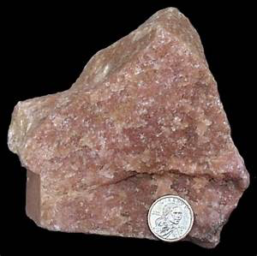
Nonfoliated Metamorphic Rocks
In some metamorphic rocks the minerals do not show any specific orientation.
This is a nonfoliated texture

Slide 36
Nonfoliated Metamorphic Rocks
Most nonfoliated metamorphic rocks form from contact or regional metamorphism
Typically the only clue metamorphism has occurred is the large grain size formed from recrystallization.

Slide 37
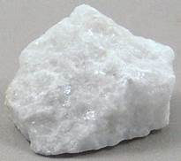
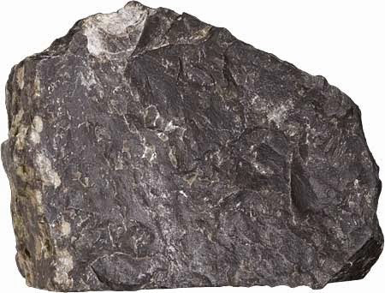
Nonfoliated Metamorphic Rocks
Nonfoliated metamorphic rocks usually fit into 2 types:
Composed of mainly one
mineral (marble or quartzite)
Those with many minerals
but grains are too small to be
seen (hornfels)

