Slide 1
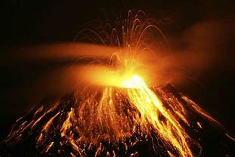
Volcanoes and Volcanism

Slide 2
Volcanoes and Volcanism
The earth’s surface is speckled with volcanoes…both active, dormant, and extinct.
Active: have erupted during recorded
history
Dormant: haven’t erupted but could in the future
Extinct: will never erupt again

Slide 3
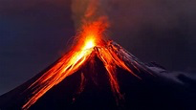
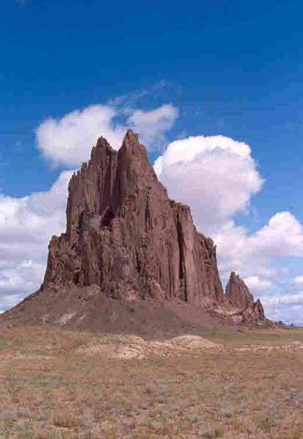
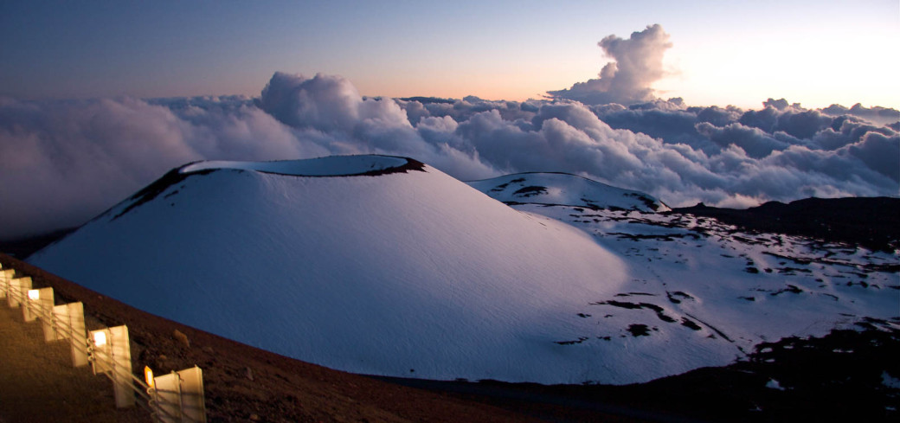

Slide 4
Volcanoes and Volcanism
Although in the short term volcanic eruptions can be quite devastating…Looking at the overall geologic history of the Earth volcanism is actually viewed as a constructive process!
Emissions have shaped our atmosphere
Island formation
Help produce productive soils

Slide 5
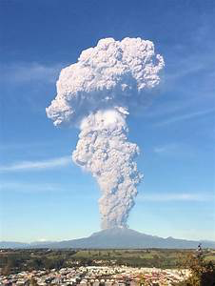
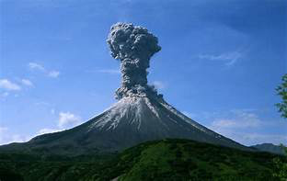
Volcanoes and Volcanism
Volcanism illustrates the complex interactions among the Earth’s systems.
A volcano is a hill or mountain that forms around a vent where lava, pyroclastic material, and gases erupt

Slide 6
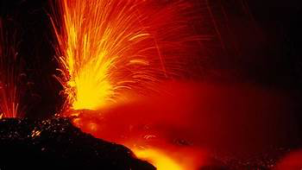
Volcanoes and Volcanism
Volcanism refers to any activity associated with the rise and release of magma and gases.
All of the terrestrial planets and Earth’s moon were volcanically active at one point.

Slide 7
Volcanic Gases
Volcanic gases have varying compositions
and usually dissipate into the atmosphere
quickly following an eruption
However….there have been events where volcanic gases have had significant climatic impacts.

Slide 8
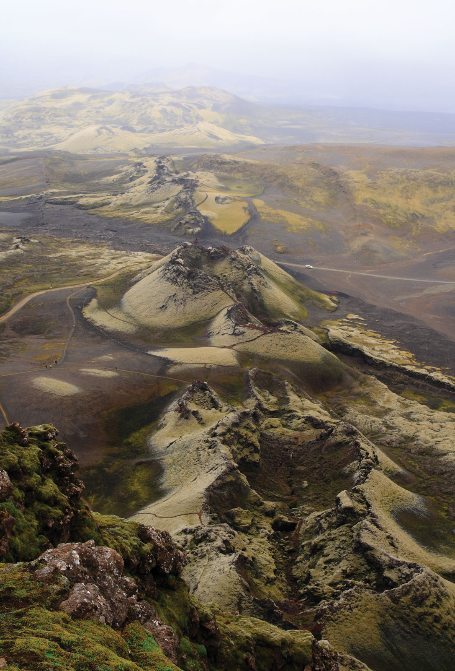
Volcanic Gases
Examples:
1783 - Blue Haze Famine
(Laki Fissure, Iceland)
-vast amounts of sulfur gases stunted crop growth across N. Europe and killed most of the domestic animals in Iceland

Slide 9
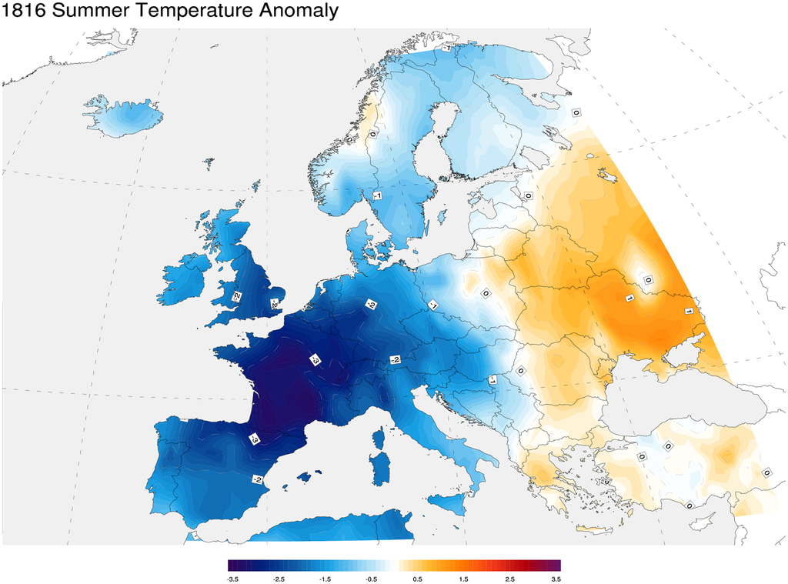
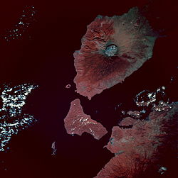
Volcanic Gases
Examples:
1815-1816
“1800 & Frozen to Death”
-Due to Mount Tambora
Eruption
Referred to as the Year
without a Summer Across the
World

Slide 10
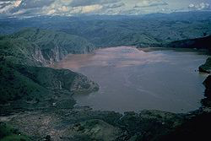
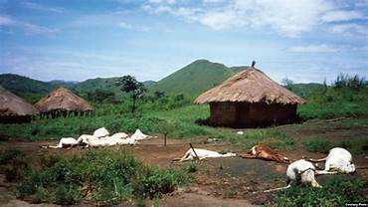
Volcanic Gases
Examples:
1986 Cameroon
-1746 people and 3500 animals died from CO₂ cloud from Lake Nyos (caldera)
-could have been the result of a landslide which triggered release of gases

Slide 11
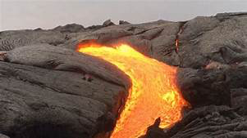
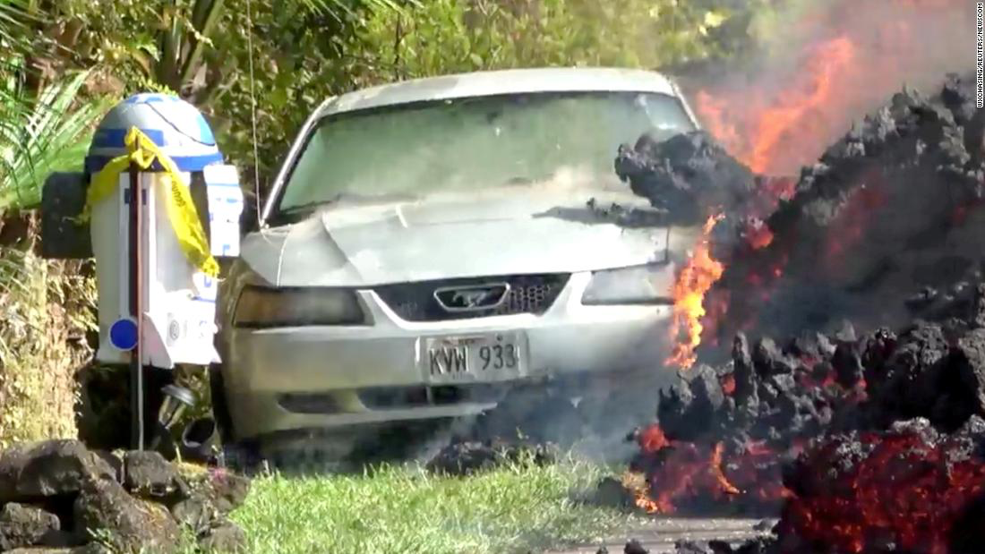
Lava Flows
A lava flow is a “river” of lava moving across the earth’s surface.
Very rarely cause fatalities
Typically don’t flow very rapidly
Follow low lying areas
Lava flows will increase speed when the edges cool and form a channel

Slide 12
https://youtu.be/ErUr4IIU-WI

Slide 13
Types of Lava
Depending on the appearance and gas content…lava can be categorized into a few different types
Types:
Pahoehoe smooth and ropey
Aa rough and jagged
Pahoehoe flows are typically hotter and thinner
Pillow Lava form when lava erupts under water.

Slide 14
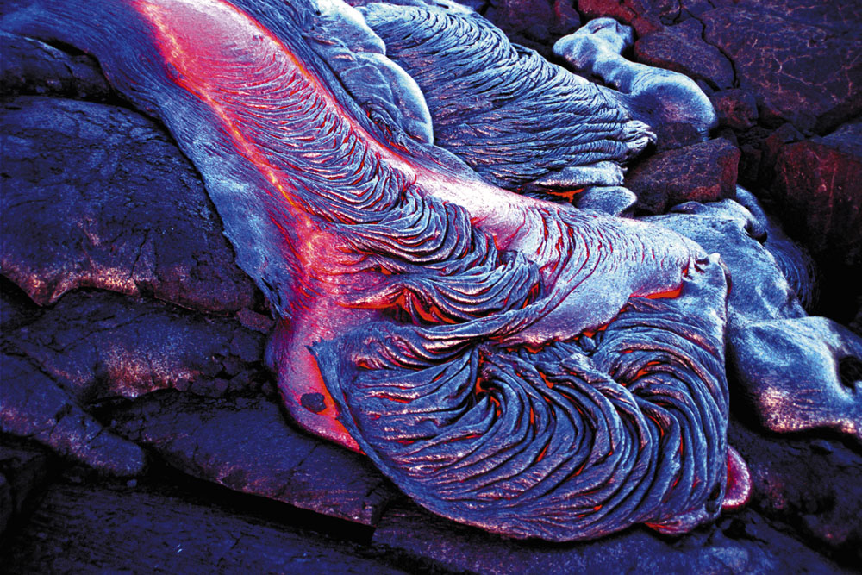
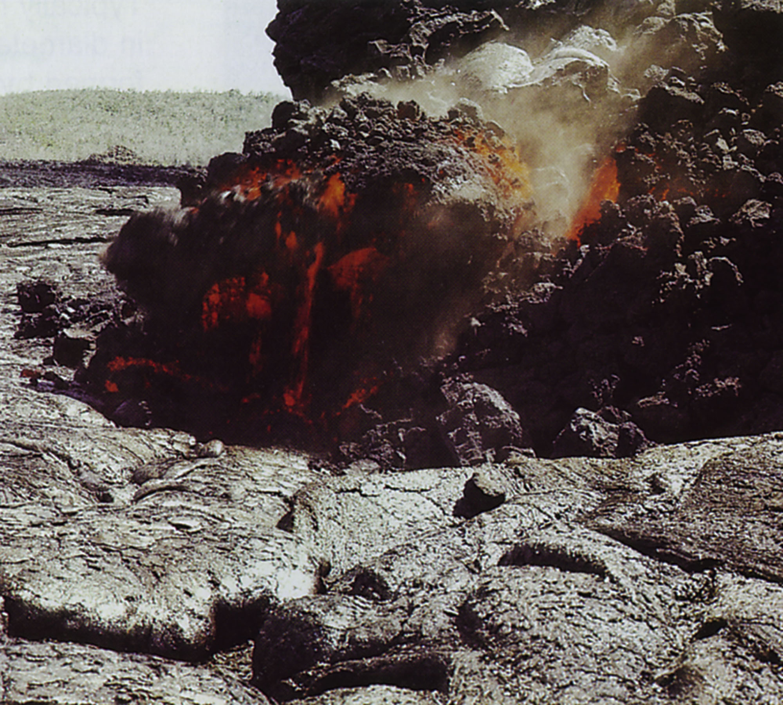
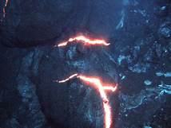
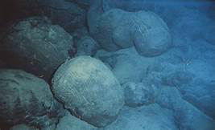
Types of Lava
Pahoehoe • Aa
Pillow Basalt

Slide 15
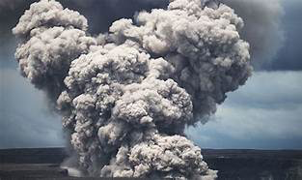
Pyroclastic Materials
In addition to lava…there are several other types of materials that can be ejected from a volcano.
Volcanic ash: material ejected from a volcano that is smaller than 2mm

Slide 16
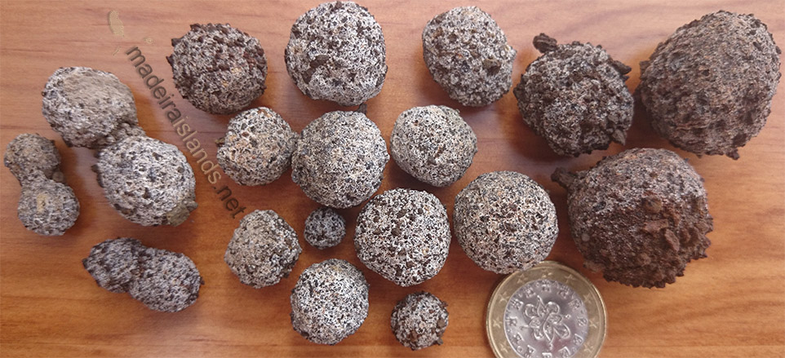
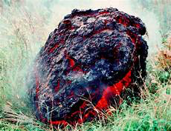
Pyroclastic Materials
Lapilli: 2mm – 64mm
Blocks and Bombs: greater than 64mm

Slide 17
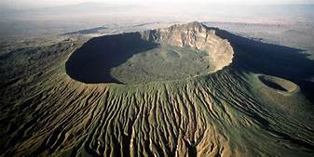
Types of Volcanoes
We know a volcano forms around a vent. There are some characteristic of all volcanoes feature
All volcanoes must have some type of conduit that leads to a magma chamber
Magma chamber is the reservoir of magma below the volcano
Volcanoes have a funnel shaped pit at the summit (top of the mountain)
This is the crater

Slide 18
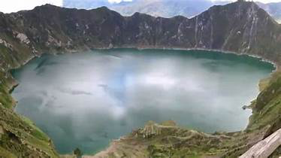
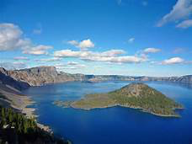
Types of Volcanoes
Volcanoes can also form
a caldera
Calderas are huge circular depressions that form after a massive eruption that empties the magma chamber and the remaining mountain collapses into it.
Ex. Crater Lake in Oregon

Slide 19
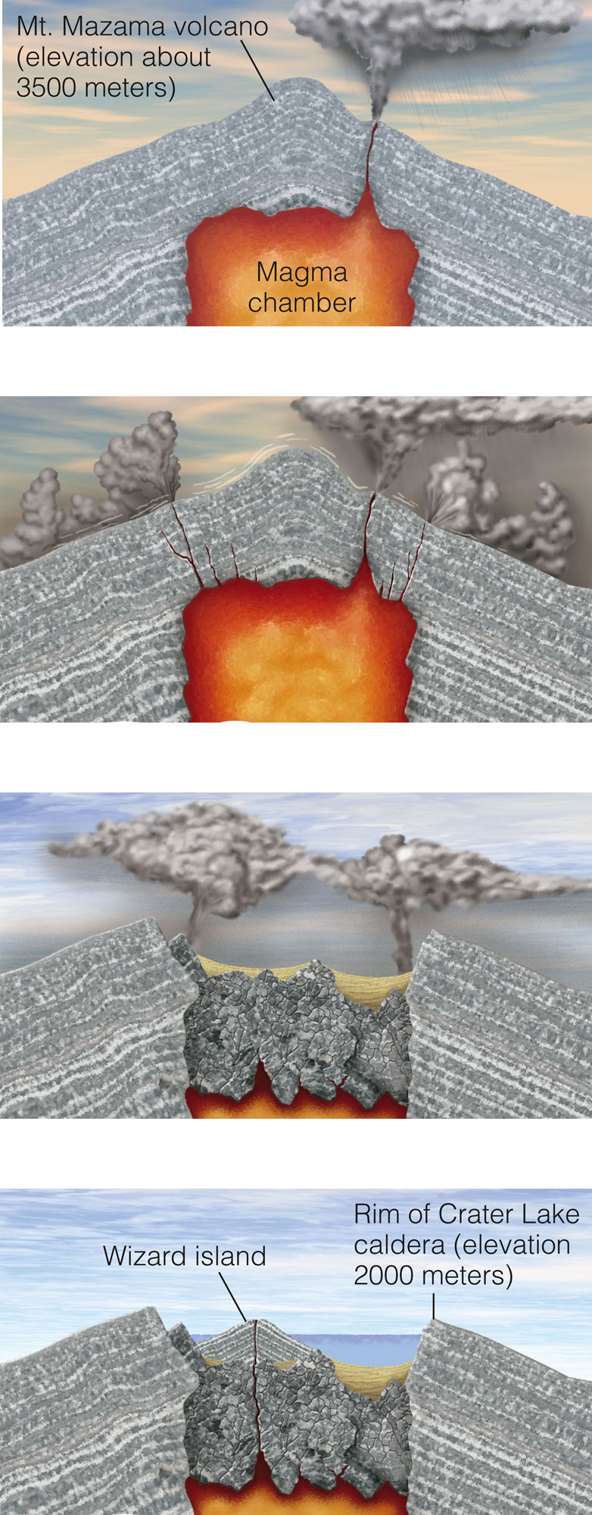
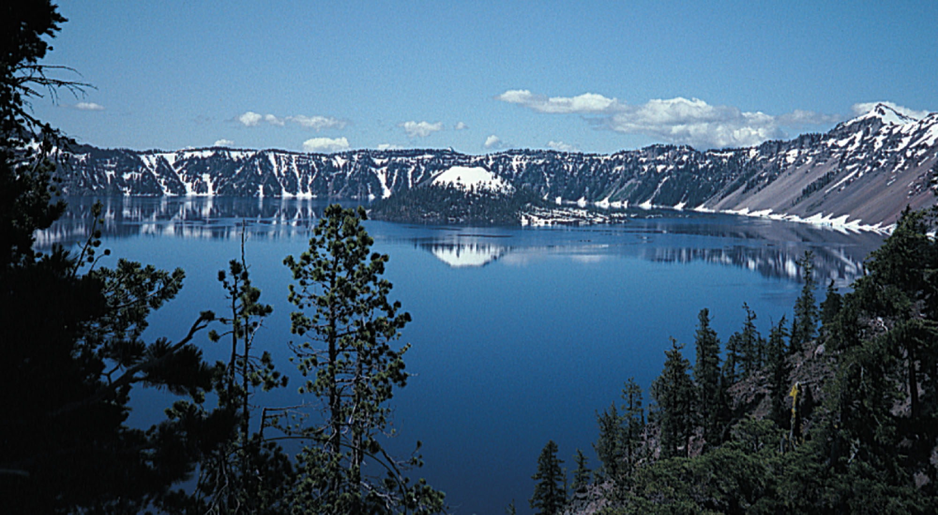

Slide 20
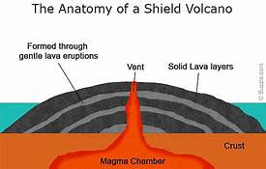
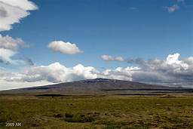
Types of Volcanoes
Geologists recognize several different types of volcanoes based on their characteristics:
Shield Cone: gently sloping sides built up by repeated lava flows
Ex. Hawaiian Islands

Slide 21
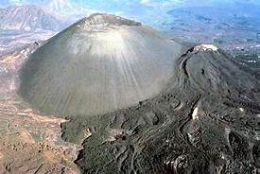
Types of Volcanoes
Cinder Cone: Small mountains (usually less than 400m) with very steeply sloping sides.
-pyroclastic eruptions
Ex. Paricutin, Mexico
Wizard Island in Oregon

Slide 22
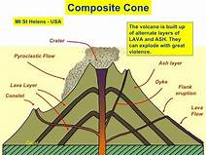
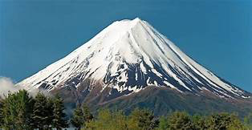
Types of Volcanoes
Composite Cone: very large mountains built by alternating episodes of lava flows followed by pyroclastic eruptions
Ex. Mount St. Helens

Slide 23
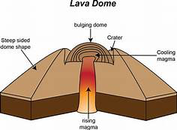
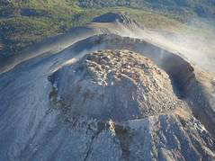
Types of Volcanoes
Lava Domes: a big rounded mountain that forms when viscous magma is forced up to the surface.
less common
These usually don’t, but can have violent and destructive eruptions if there is built up pressure

