Slide 1
Astronomy…
What is it?

Slide 2
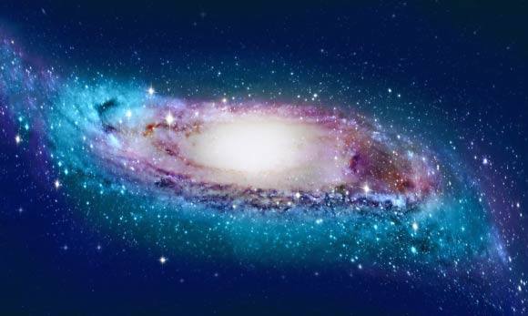
Astronomy….What is it?
It’s the study of the Universe and everything that’s in it.
So … where do we begin?
Let’s start by finding out where we are!

Slide 3
Terrestrial Coordinate System
How would you tell someone where we are located?
Verbal Description
An Address (similar to using a coordinate system…just like the coordinates on a graph!)
** To use a coordinate system you must determine the ZERO POINT

Slide 4
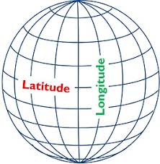
Terrestrial Coordinate System
So…what’s the coordinate system for locating a place on Earth’s surface?
Latitude and Longitude
Latitude: the angle between the equator and a geographical location.
Longitude: the angle (E or W) around the equator to the point nearest the location.

Slide 5
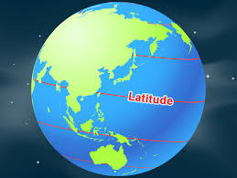
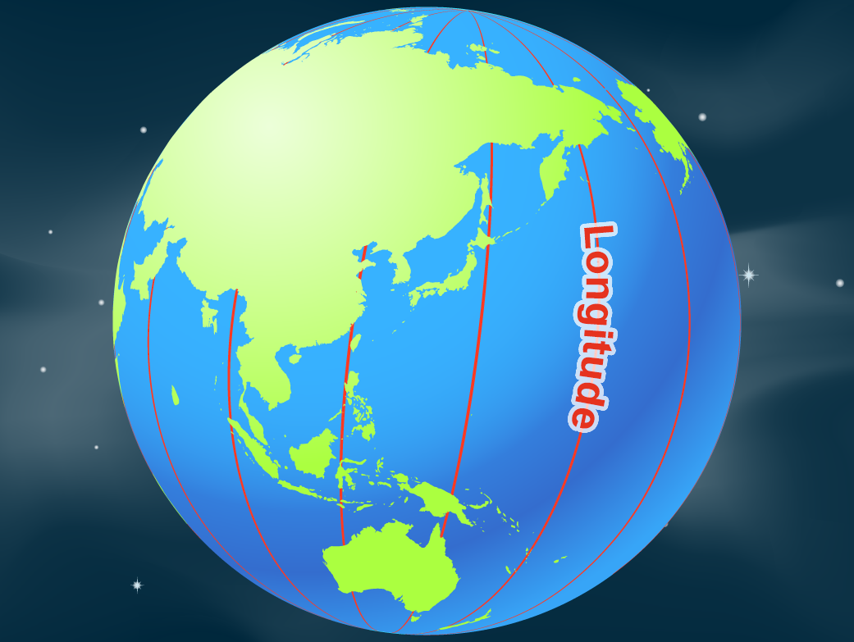
Terrestrial Coordinate System
What is the zero point?
Latitude: the equator
Longitude: the prime
meridian

Slide 6
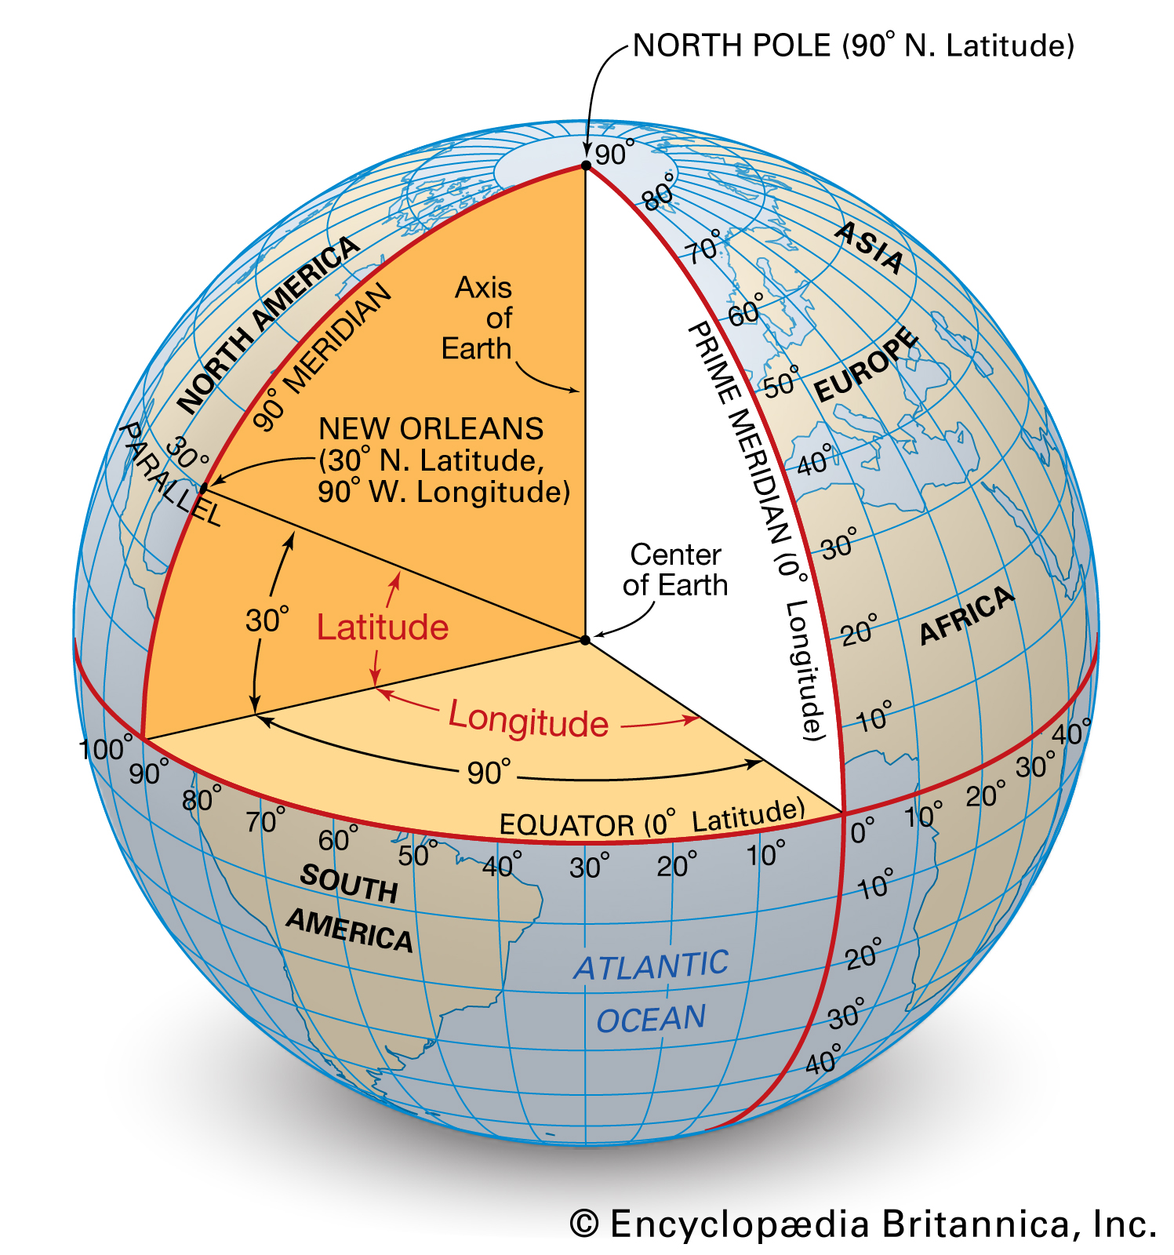
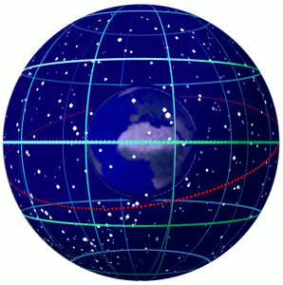
Terrestrial Coordinate System
Ok…latitude and longitude are the coordinates we use to locate a position on the earth’s surface.
What coordinate system is used to locate objects in the sky?

Slide 7
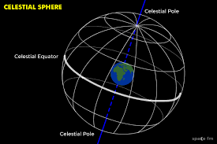
The Celestial Sphere
The Celestial Sphere refers to the appearance of the night sky being similar to an inverted bowl.
Referred to as the “Bowl of Night”

Slide 8
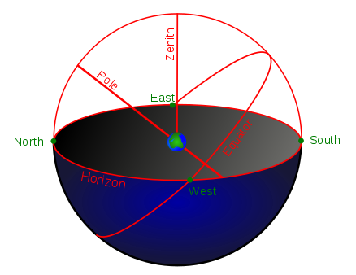
The Celestial Sphere
Whatever we see from earth (moon, stars, etc.) is considered to be a part of the Celestial Sphere
The Celestial Sphere completely surrounds the Earth. We only see the hemisphere above our horizon.

Slide 9
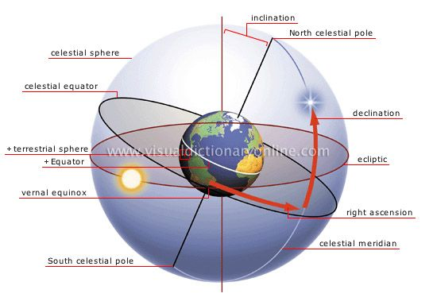
Celestial Sphere
So…now we know what we are looking at in the night sky….let’s think about how to locate something….

Slide 10
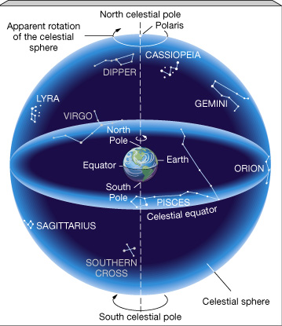
Angular Measurements
To locate stars on the celestial sphere we must use angular measurements.
Commonly measured in terms of degrees.

Slide 11
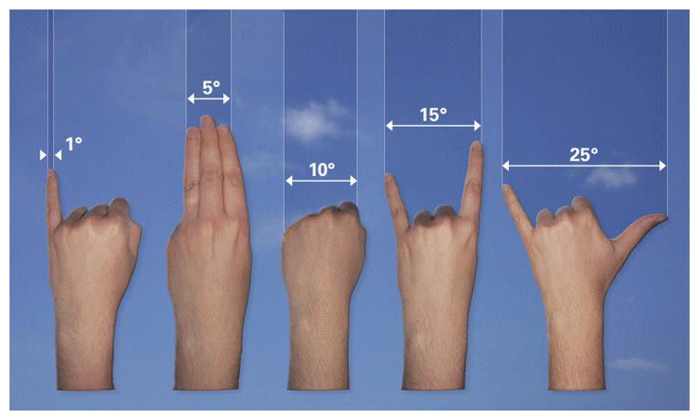
Angular Measurements
A few handy approximations:
2° = width across your finger
10° = width across your knuckles
20° = width across your hand outstretched

Slide 12
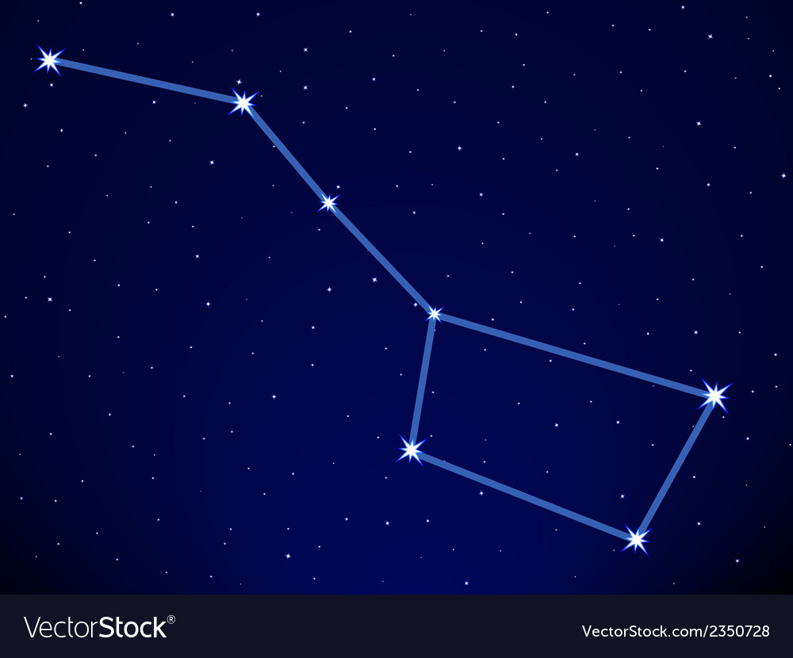
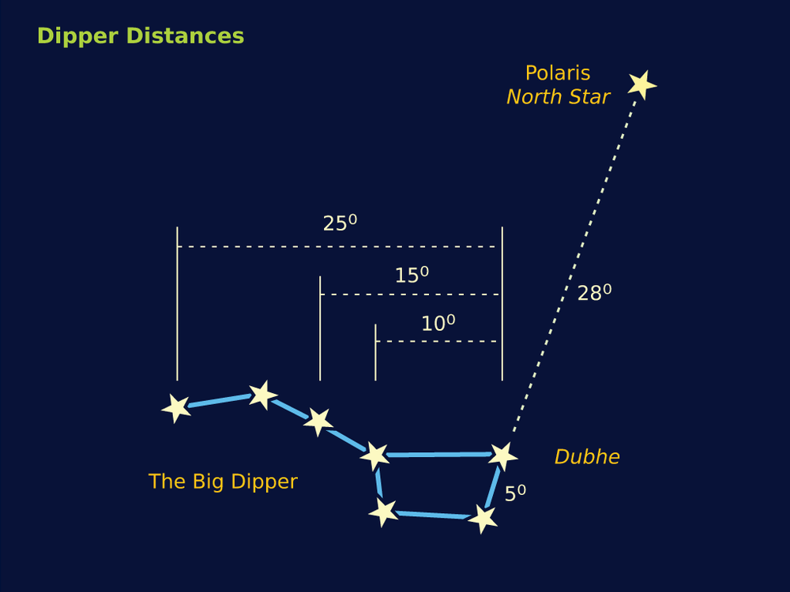
Angular Measurements
Most Constellations range in size from a few degrees to 10’s of degrees.
Ex… The Big Dipper is about 25° across.

Slide 13
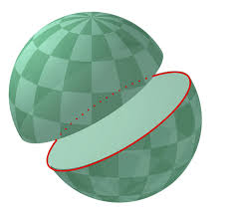
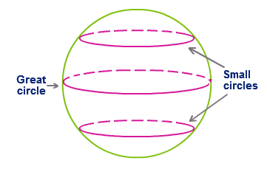
Horizon System
The Horizon System of locating has 3 points in common with latitude/longitude:
Both systems are based on Great Circles.
So what’s a Great Circle?
A circle that divides a sphere
into 2 equal hemispheres.
(ex. Equator)

Slide 14
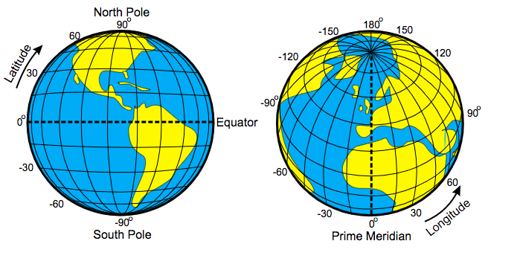
Horizon System
One coordinate is measured along the great circle (ex. Longitude).
The other is measured above or below the great circle. (ex. Latitude)

Slide 15
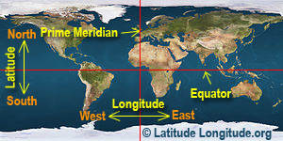
Horizon System
The zero point could have been chosen anywhere along the great circle.
• choice is arbitrary, but everyone must then use the same one.

Slide 16
Horizon System
The great circle this system is based on is called the horizon.
Celestial Horizon NOT the line separating the sky and earth.

Slide 17
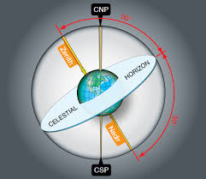
Horizon System
Celestial Horizon is defined with respect to the zenith.
The zenith is the point on the celestial sphere that is directly overhead.

Slide 18
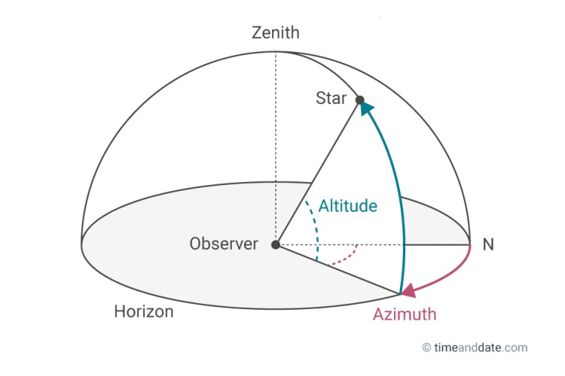
Horizon System
Coordinates used in the Horizon System:
Altitude: angular distance above the celesital horizon. (corresponds to latitude)

Slide 19
Horizon System
Coordinates used in the Horizon System:
Azimuth: angular distance measured eastward from North around the celestial horizon. (corresponds to longitude)

Slide 20
Horizon System
Pros & Cons of the Horizon System:
Advantage - Simplicity!
Disadvantage - as you change your locations or the time of observation… you change the altitude and azimuth you are using to describe a stars position.
** this is because the celestial sphere appears to rotate with us.

